Slide 1
Soft Updates Made Simple and Fast on Non-volatile Memory
ATC ‘17
Mingkai Dong, Haibo Chen
Institute of Parallel and Distributed Systems,
Shanghai Jiao Tong University
Notes:
Thanks for the introduction. Hello everyone, my name is Mingkai Dong from IPADS, SJTU. It’s my honor to be here sharing our work “Soft updates made simple and fast …”. The work is done with my advisor Haibo Chen.

Slide 2
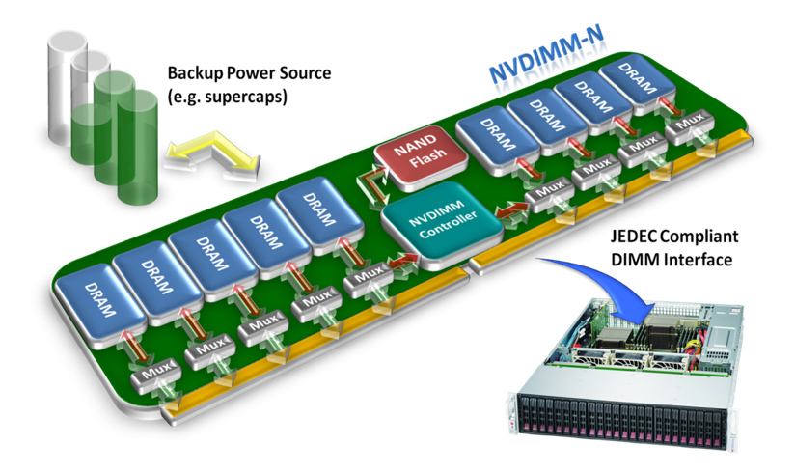
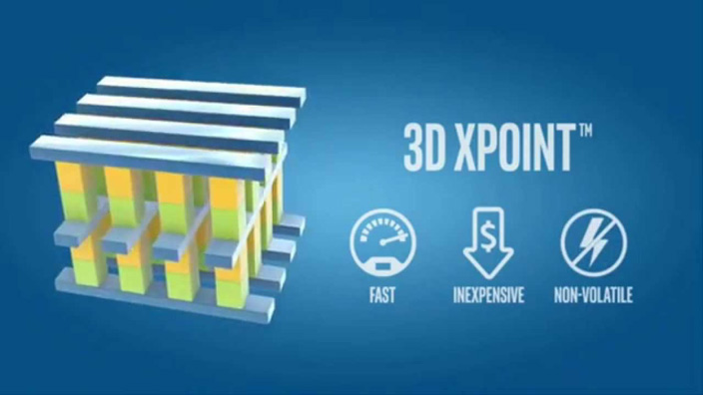
Non-volatile Memory (NVM)
Non-volatile
Byte-addressable
High throughput and low latency
Notes:
NVM is an emerging memory technology that is non-volatile, byte-addressable with high throughput and low latency.
As the techniques such as NVDIMM and 3DX-Point, NVM becomes a promising replacement for disks.

Slide 3
NVM File Systems (NVMFS)
Existing NVMFS use journaling or copy-on-write for crash consistency
Synchronous cache flushes are necessary
Cache flushes are expensive!
Other options for crash consistency?
A
A’
File System
Metadata
Journal
Area
inode
inode
B
C
C’
D
E
E’
Notes:
To fully utilize the features of NVM, there are several FS designed for NVM such as PMFS and NOVA.
These systems use journaling or copy-on-writing to provide crash consistency.
However, both of these techniques require synchronous cache flushes which are expensive.
So is there any other option for crash consistency?

Slide 4
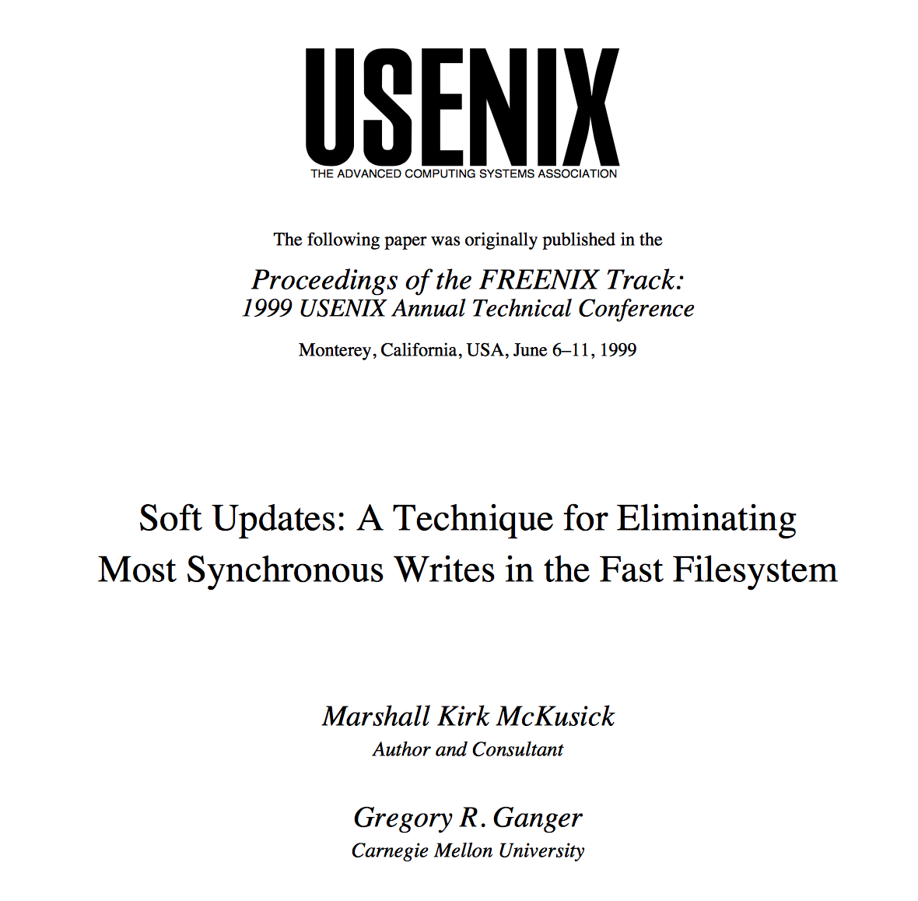
NVM File Systems (NVMFS)
Existing NVMFS use journaling or copy-on-write for crash consistency
Synchronous cache flushes are necessary
Cache flushes are expensive!
Other options for crash consistency?
A
A’
File System
Metadata
Journal
Area
inode
inode
B
C
C’
D
E
E’
Notes:
The answer is yes, we have soft updates. Soft updates is a technique for eliminating most synchronous writes in File systems.

Slide 5
Soft Updates
DRAM (Page cache)
Latest metadata in DRAM
Updated in DRAM with dependency tracked
DRAM performance
No synchronous disk writes
Consistent metadata in disks
Persisted to disks with dependency enforced
Always consistent
Immediately usable after crash
DISK
Traditional Soft Updates
Notes:
The main idea of soft updates is to leverage the page cache to store latest metadata in DRAM and keep the in-disk metadata consistent.
All the updates are firstly done in DRAM with the dependencies tracked.
These updates in DRAM are persisted to disks by background threads, with respect to the dependencies tracked.
As a result, there are no synchronous disk writes and the metadata operations can be done with DRAM performance. And the metadata in disks are always consistent so that can be immediately used after crashes, without lengthy recoveries.

Slide 6
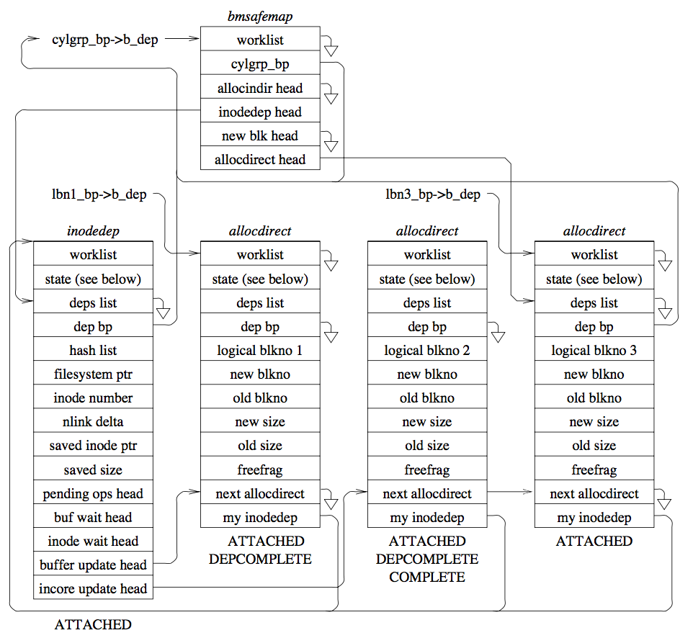
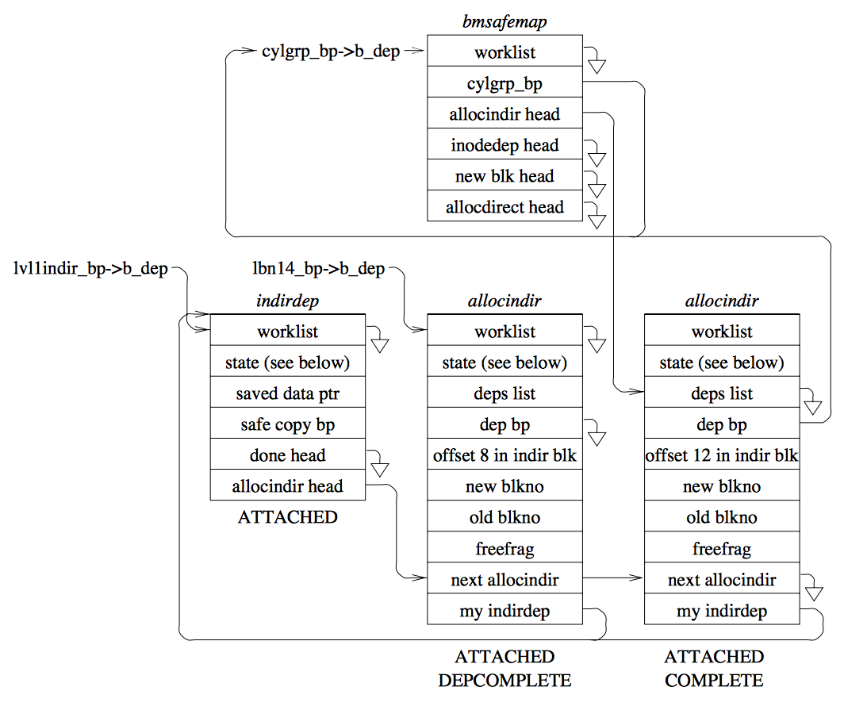
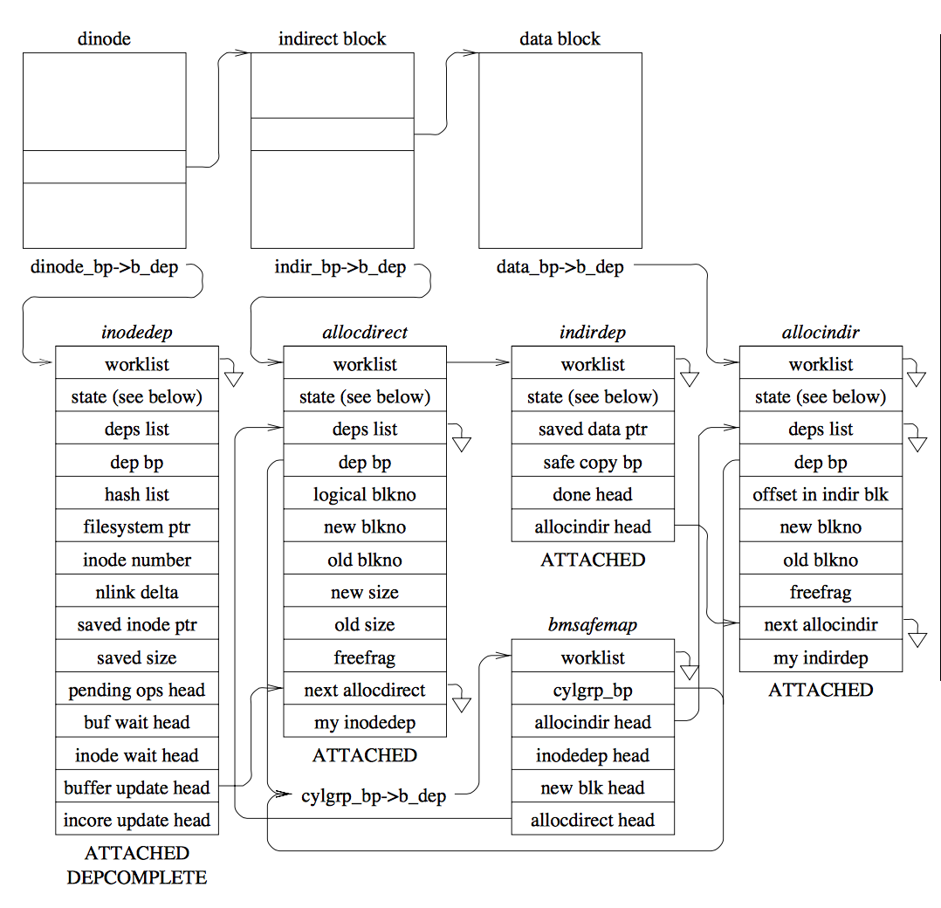
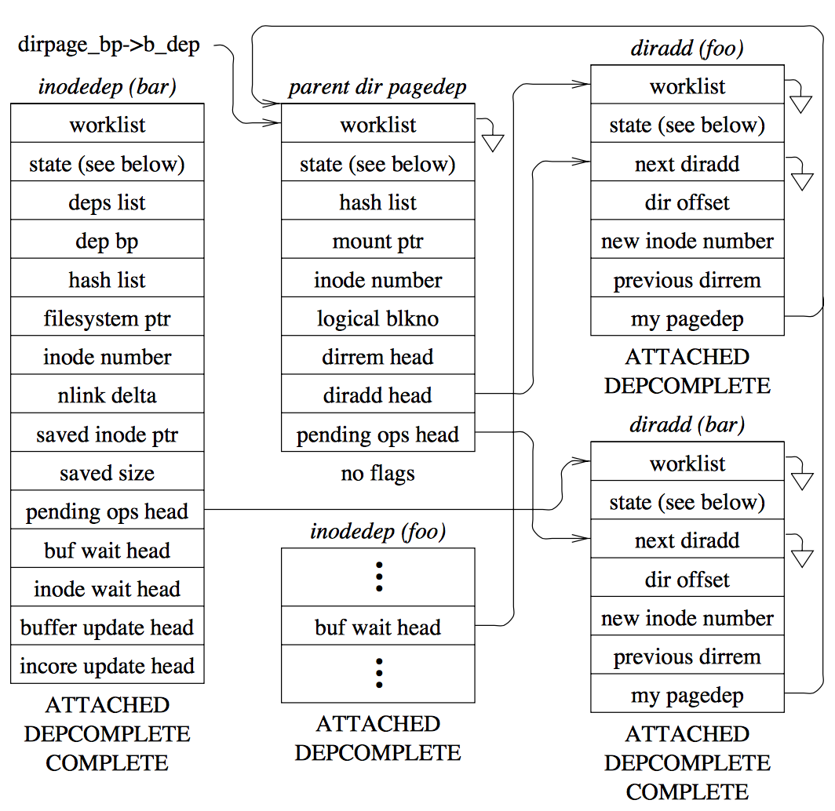
Soft Updates Is Complicated
Delayed disk writes
Auxiliary structures for each update
More complex dependencies
Figures from Soft Updates: A Technique for Eliminating Most Synchronous Writes in the Fast Filesystem, ATC ’99
Notes:
Soft updates delays the disk writes to eliminate the synchronous disk writes.
Soft updates track these writes in pointer level but the disk can only be updates by block, it thus needs auxiliary structures for each updates to track the dependencies.
This figure shows the structures for allocating a data block, which are very complex. Auxiliary structures are also necessary for other updates and here are two more examples.

Slide 7
Soft Updates Is Complicated
Delayed disk writes
Auxiliary structures for each operation
More complex dependencies
Cyclic dependencies
Rolling back/forward
inode Block
Directory Block
inode #4
<A, #4>
inode #5
<--, #0>
Inode #6
Inode #7
<E, #7>
inode block
(in page cache)
inode block
inode block
inode block
inode #4
Rollback
inode #6
inode #4
inode #4
Rollforward
inode #6
inode #4
Flush block to disks
inode #5
inode #5
inode #5
inode #5
inode #6
inode #6
inode #6
inode #6
inode #7
inode #7
inode #7
inode #7
Examples from Soft Updates: A Solution to the Metadata Update Problem in File Systems, TOCS 2000
Notes:
Data structures like inodes are usually smaller than a block. Thus we usually store multiple inodes in one block, causing false sharing and leading to cyclic dependencies.
The figure on the right sides shows an example, in which one dependency says the inode block shell be persisted before the directory block. While the other dependency says the directory block shell be persisted first.
Soft updates have to use rolling back/forward to resolve these cyclic dependencies.
By using rolling-back/forward, when we want to flush the inode block to disks, we need firstly to rollback the updates of inode 6, then flushing the block to disks.
After the flush, we need to rollforward the updates of inode 6.
This procedure is very complex.

Slide 8
Soft Updates Is Complicated
Delayed disk writes
Auxiliary structures for each operation
More complex dependencies
Cyclic dependencies
Rolling back/forward
The mismatch between per-pointer-based dependency tracking
and block-based interface of traditional disks
Notes:
By reviewing this two points, we conclude that the core reason of the complexity is the mismatch b/t per-pointer-based dependency tracking and block-based interface of traditional disks.

Slide 9
Soft Updates Meets NVM
Soft Updates
No synchronous cache flushes
Immediately usable after crash
NVM: byte-addressable and fast
Direct write to NVM without delays
No false sharing => no rolling back/forward
Simple dependency tracking/enforcement
 | Update Granularity | Speed | Access
Disk | Block | Slow | Disk Command
NVM | Byte (Cache Line) | Fast | Load/Store CPU Instructions
Notes:
But now, we have NVM.
By using soft updates, we can remove all synchronous cache flushes in most metadata operations
And we can immediately use the stored metadata after crashes without lengthy recovery.
On the other hand, because NVM is byte-addressable and fast. We can eliminate false sharing by design thus we don't need to roll back/forward anymore.
We can also bypass the page cache and directly write to NVM and simplify the dependency tracking and enforcement and we don’t need the rollback and forward anymore.

Slide 10
SoupFS
A simple and fast NVMFS derived from soft updates
Hashtable-based directories
No false sharing
Pointer-based dual views
No synchronous cache flushes
Semantic-aware dependency tracking/enforcement
Simple dependency tracking/enforcement
Get the best of both Soft Updates and NVM
Notes:
To make soft updates simple and fast on NVM, we design a NVMFS called SoupFS which uses hashtable-based directories, pointer-based dual views and semantic-aware dependency tracking and enforcement to get the best of both world.

Slide 11
Overview
Background
Design & Implementation
Hashtable-based directories
Pointer-based dual views
Semantic-aware dependency tracking/enforcement
Evaluation
Conclusion

Slide 12
Overview
Background
Design & Implementation
Hashtable-based directories
Pointer-based dual views
Semantic-aware dependency tracking/enforcement
Evaluation
Conclusion

Slide 13
Block-based Directories
Block-based file systems usually use block-based directories
False sharing
Cyclic dependency
Rolling back/forward
Slow access
Linear scan
1.TxT|32
2
.TxT|38
indirect
block
fs-long-lon
Directory inode
g.exe|512
l+f.dir|12
Notes:
Block-based file systems usually use block-based directories.
One drawback is that variable-length dentries are usually stored in blocks one by one like an array.
This might cause cyclic dependencies and requires rolling-back/-forward, complicating the file system design.
Another drawback is that in some file systems, the lookup of a dentry requires linearly scanning the whole directores. Which is very slow as the directory grows larger.

Slide 14
Hashtable-based Directories
Optimized for cache lines
No false sharing
No cyclic dependency
Efficient access
No linear scan
Directory inode
Buckets
0
1
2
3
4
…
Filename
Pointer
inode Pointer
Latest Next
Consistent Next
Hash
Len
Filename
inode
Hashtable-based directories simplify dependencies in SoupFS
Notes:
SoupFS thus uses hashtable-based directories, leveraging the byte-addresssability of NVM.
Each directory is a hash table and the list entry consisting of the pointers to the filename, to the inode and next entries in the hash table as shown in the figure.
The hash table design is optimized for cache lines thus there is no false sharing and cyclic dependencies.
It also boosts the directory access compared to the linearly scan.
//Most of these structures are fixed to 64B which is the size of a cache line.
As a result, we can have faster accesses and there is no false sharing and cyclic dependencies.

Slide 15
Overview
Background
Design & Implementation
Hashtable-based directories
Pointer-based dual views
Semantic-aware dependency tracking/enforcement
Evaluation
Conclusion

Slide 16
Dual Views
DRAM (Page cache)
Latest view in page cache
Consistent view in disks
Dual views
Eliminate synchronous writes
Provide usability after crash
DISK
Traditional Soft Updates
Notes:
Original soft updates provides dual views of metadata. It provides the latest view in page cache and maintain the consistent view in disks.
Dual views is very important for eliminating synchornous writes and providing usablity after crashes.

Slide 17
Dual Views
DRAM
Latest view?
Consistent view in NVM
Another copy of metadata in DRAM
Double writes
Double storage overhead
Unnecessary synchronizations
NVM
Challenge: How to present latest view efficiently?
Soft Updates on NVM
Notes:
But now, we have NVM and the page cache is not necessary and usually removed for performance.
To preserve the dual views, one option is to still maintain another copy of the metadata in DRAM. However this doubles the write operations and the storage overhead, and requires synchronizations between the two copies.

Slide 18
Pointer-based Dual Views
DRAM
Reuse data structures in both views
Distinguish views by different pointers/structures
NVM
Soft Updates on NVM
Notes:
Our solution is the pointer-based dual views.
The key idea is to reuse some data structures in both views but to ensure that different views can be observed by following different pointers/structures.

Slide 19
Pointer-based Dual Views
Directory inode
Buckets
Volatile in DRAM
Updates to NVM w/o persistence guarantee
0
1
2
3
4
…
Persisted in NVM
Directory
VFS inode
D
C
B
A
Filename
inode
Latest
Next
Consistent
Next
Latest View
Dir
File A
File B
File C
File D
Consistent View
Dir
File A
File B
File C
File D
Notes:
Here is an example where we have four files in a directory. The light orange colors present the volatile data, the blank shows the volatile data in NVM, that is the data we have written to the memory address but there is no guarantee whether it is written in the NVM or stored in the CPU cache.
The light blue prevents the data that is persisted in NVM.
The two boxes on the right bottom corner show what we can observe in two views.
Next, I’ll show how the dual views work.

Slide 20
Pointer-based Dual Views
Directory inode
Buckets
Volatile in DRAM
Updates to NVM w/o persistence guarantee
0
1
2
3
4
…
Persisted in NVM
Directory
VFS inode
D
C
B
A
Filename
inode
Latest
Next
Consistent
Next
Latest View
Dir
create E
File A
File B
File C
File D
File E
Consistent View
Dir
File A
File B
File C
File D
Notes:
When we want to add a file to the directory.

Slide 21
Pointer-based Dual Views
Directory inode
Buckets
Volatile in DRAM
Updates to NVM w/o persistence guarantee
0
1
2
3
4
…
Persisted in NVM
Directory
VFS inode
D
C
B
A
Filename
inode
Latest
Next
Consistent
Next
Latest View
Dir
Latest Buckets
create E
File A
File B
File C
File D
File E
Consistent View
Dir
File A
File B
File C
File D
Notes:
We need to add a list to the hash table. We then first creates lates buckets to store the new list headers.

Slide 22
Pointer-based Dual Views
Directory inode
Buckets
Volatile in DRAM
Updates to NVM w/o persistence guarantee
0
1
2
3
4
…
Persisted in NVM
Directory
VFS inode
D
C
B
A
Filename
inode
Latest
Next
Consistent
Next
Latest View
E
Dir
Latest Buckets
create E
File A
File B
File C
File D
File E
Consistent View
Dir
File A
File B
File C
File D
Notes:
Then we allocate the initializes the a entry in NVM.

Slide 23
Pointer-based Dual Views
Directory inode
Buckets
Volatile in DRAM
Updates to NVM w/o persistence guarantee
0
1
2
3
4
…
Persisted in NVM
Directory
VFS inode
D
C
B
A
Filename
inode
Latest
Next
Consistent
Next
Latest View
E
Dir
Latest Buckets
create E
File A
File B
File C
File D
File E
3
Consistent View
Dir
File A
File B
File C
File D
Notes:
After which we inserted the dentry in the latest buckets.

Slide 24
Pointer-based Dual Views
Directory inode
Buckets
Volatile in DRAM
Updates to NVM w/o persistence guarantee
0
1
2
3
4
…
Persisted in NVM
Directory
VFS inode
D
C
B
A
Filename
inode
Latest
Next
Consistent
Next
Latest View
E
Dir
Latest Buckets
create E
File A
File B
File C
File D
File E
3
Consistent View
Dir
File A
File B
File C
File D
Notes:
The insertion is done, but not persisted.

Slide 25
Pointer-based Dual Views
Directory inode
Buckets
Volatile in DRAM
Updates to NVM w/o persistence guarantee
0
1
2
3
4
…
Persisted in NVM
Directory
VFS inode
D
C
B
A
Filename
inode
Latest
Next
Consistent
Next
Latest View
E
Dir
Latest Buckets
create E
unlink B
File A
❌
File B
File C
File D
File E
3
Consistent View
Dir
File A
File B
File C
File D
Notes:
When we want to remove a file, we need to remove a dentry in the hash table.

Slide 26
Pointer-based Dual Views
Directory inode
Buckets
Volatile in DRAM
Updates to NVM w/o persistence guarantee
0
1
2
3
4
…
Persisted in NVM
Directory
VFS inode
D
C
B
A
Filename
inode
Latest
Next
Consistent
Next
Latest View
E
Dir
Latest Buckets
create E
unlink B
File A
❌
File B
File C
File D
File E
3
Consistent View
Dir
File A
File B
File C
File D
Notes:
We can simply modify the latest next pointer of its previous dentry to point to the next dentry like this.

Slide 27
Pointer-based Dual Views
Directory inode
Buckets
Volatile in DRAM
Updates to NVM w/o persistence guarantee
0
1
2
3
4
…
Persisted in NVM
Directory
VFS inode
D
C
B
A
Filename
inode
Latest
Next
Consistent
Next
Latest View
E
Dir
Latest Buckets
create E
unlink B
File A
❌
File B
File C
File D
File E
3
Consistent View
Dir
File A
File B
File C
File D
Notes:
Now both the latest view and the consistent view can be retrieved from this figures.

Slide 28
Pointer-based Dual Views
Directory inode
Volatile in DRAM
Directory inode
Buckets
Updates to NVM w/o persistence guarantee
0
1
2
3
4
…
0
1
2
3
4
…
Persisted in NVM
Directory
VFS inode
D
C
B
A
Filename
inode
Latest
Next
Consistent
Next
Latest View
E
Dir
Latest Buckets
create E
unlink B
File A
❌
File B
File C
File D
File E
3
Consistent View
Dir
✔
✔
✔
✔
File A
File B
File C
File D
Notes:
For the consistent view, we only consider the data stored in the NVM and the consistent pointers. So in this example, we can see dentry D, C, B and A.

Slide 29
Pointer-based Dual Views
Directory inode
Volatile in DRAM
Directory inode
Buckets
Updates to NVM w/o persistence guarantee
0
1
2
3
0
1
2
3
4
…
Persisted in NVM
Directory
VFS inode
D
C
B
A
Directory
VFS inode
Filename
inode
Latest
Next
Consistent
Next
Latest View
E
Dir
Latest Buckets
create E
unlink B
✔
❌
✔
✔
✔
File A
File B
File C
File D
File E
3
3
Consistent View
Dir
File A
File B
File C
File D
Notes:
For the latest views, we consider both the data in DRAM and NVM. We will follow the latest next pointers if not null.
So we can observe dentry D, E, C and A in the latest view.

Slide 30
Pointer-based Dual Views
Directory inode
Buckets
Volatile in DRAM
Updates to NVM w/o persistence guarantee
0
1
2
3
4
…
Persisted in NVM
Directory
VFS inode
D
C
B
A
Filename
inode
Latest
Next
Consistent
Next
Latest View
E
Dir
Latest Buckets
create E
unlink B
File A
❌
File B
File C
File D
File E
3
Consistent View
Dir
File A
File B
File C
File D
Notes:
When we want to persist the operations.

Slide 31
Pointer-based Dual Views
Directory inode
Buckets
Volatile in DRAM
Updates to NVM w/o persistence guarantee
0
1
2
3
4
…
Persisted in NVM
Directory
VFS inode
D
C
B
A
Filename
inode
Latest
Next
Consistent
Next
Latest View
E
Dir
Latest Buckets
create E
unlink B
File A
❌
File B
File C
File D
File E
3
Consistent View
Dir
File A
File B
File C
File D
Notes:
We first make sure that all the updates in NVM are persisted.

Slide 32
Pointer-based Dual Views
Directory inode
Buckets
Volatile in DRAM
Updates to NVM w/o persistence guarantee
0
1
2
3
4
…
Persisted in NVM
Directory
VFS inode
D
C
B
A
Filename
inode
Latest
Next
Consistent
Next
Latest View
E
Dir
Latest Buckets
create E
unlink B
File A
❌
File B
File C
File D
File E
3
Consistent View
Dir
File A
File B
File C
File D
File E
Notes:
Then we carefully and synchronously modify the in-NVM data structures to persist the insertions and removals.

Slide 33
Pointer-based Dual Views
Directory inode
Buckets
Volatile in DRAM
Updates to NVM w/o persistence guarantee
0
1
2
3
4
…
Persisted in NVM
Directory
VFS inode
D
C
B
A
Filename
inode
Latest
Next
Consistent
Next
Latest View
E
Dir
Latest Buckets
create E
unlink B
File A
❌
File B
File C
File D
File E
3
Consistent View
Dir
File A
❌
File B
File C
File D
File E
Notes:
Then we carefully and synchronously modify the in-NVM data structures to persist the insertions and removals.

Slide 34
Pointer-based Dual Views
Directory inode
Buckets
Volatile in DRAM
Updates to NVM w/o persistence guarantee
0
1
2
3
4
…
Persisted in NVM
Directory
VFS inode
D
C
B
A
Filename
inode
Latest
Next
Consistent
Next
Latest View
E
Dir
Latest Buckets
create E
unlink B
File A
❌
File B
File C
File D
File E
3
Consistent View
Dir
File A
❌
File B
File C
File D
File E
Notes:
Finally we can reclaims the removed structures.

Slide 35
Pointer-based Dual Views
DRAM
Reuse data structures in both views
Distinguish views by different pointers/structures
Eliminate synchronous writes
Provide usability after crash
No double write
Little space overhead
NVM
Soft Updates on NVM
Pointer-based dual views preserve fast crash recovery in SoupFS
Notes:
By using pointer-based dual views,
we can provides what the dual views can provide with no double writes and little space overhead

Slide 36
Overview
Background
Design & Implementation
Hashtable-based directories
Pointer-based dual views
Semantic-aware dependency tracking/enforcement
Evaluation
Conclusion

Slide 37
Dependency Tracking
Auxiliary structures for each updates
Notes:
Original soft updates needs many complex structures to maintain the dependencies among operations.

Slide 38
Dependency Tracking
Auxiliary structures for each updates
The semantic gap between
the page cache (where enforcement happens)
and the file system (where tracking happens)
After removing page cache, SoupFS involves semantics in dependency tracking/enforcement
Notes:
We found that this complexity comes from the gap between the page cache where …
Since in the page cache layer, it doesn’t know what is in the data and what modifications are in the page.

Slide 39
Semantic-aware Dependency Tracking
Track semantic operations with complementary information
Enough for dependency enforcement
Operations are stored in operation list of each VFS inode
dirty inode list
VFS inode
VFS inode
VFS inode
list next
list next
list next
operation list
operation list
operation list
list next
operation type
Complimentary
information
Notes:
For each inode, we maintain a list of this operations on this inode and keep a list of dirty inodes.

Slide 40
Semantic-aware Dependency Enforcement
Persister daemons traverse the dirty inode list in background
persist each operation from the latest view to the consistent view with respect to update dependencies
dirty inode list
VFS inode
VFS inode
VFS inode
list next
list next
list next
operation list
operation list
operation list
list next
operation type
Complimentary
information
Notes:
To enforce the dependencies, we simply traverse the operation lists and do the persistence according to the operation type and recorded complimentary information. Since with the pointers we tracked is enough for knowing what happened.

Slide 41
Overview
Background
Design & Implementation
Hashtable-based directories
Pointer-based dual views
Semantic-aware dependency tracking/enforcement
Evaluation
Conclusion

Slide 42
Evaluation Setup
Platform
Intel Xeon E5 server with two 8-core processors
48 GB DRAM and 64 GB NVDIMM
File Systems
SoupFS, PMFS, NOVA, Ext4-DAX, Ext4
NVM Write Delay Simulation
ndelay() after clflush
Benchmarks
Micro-benchmarks: 100 iterations of 10⁴ create/unlink/mkdir/rmdir
Filebench and Postmark

Slide 43
Micro-benchmark Latency
Inefficient Directory Organization
Lowest Latency

Slide 44
Sensitivity to NVM Write Delay
↑~250%
↑~200%
No effect

Slide 45
Postmark & Filebench
↑~50%

Slide 46
Overview
Background
Design & Implementation
Hashtable-based directories
Pointer-based dual views
Semantic-aware dependency tracking/enforcement
Evaluation
Conclusion

Slide 47
Conclusion
Soft updates is complicated due to the mismatch between per-pointer-based dependency tracking and block-based interface of traditional disks
We design and implement SoupFS
Hashtable-based directories
Pointer-based dual views
Semantic-aware dependency tracking/enforcement
Soft updates can be made simple and fast on NVM
Notes:
22 minutes in total

Slide 48

Thanks & Questions?

